Slide 1
The Third Eye
-Object Detection and Recognition
By-
Ayush Mishra(1501CS16)
Rijul Dhir(1501CS37)
Sahil Sharma(1501CS40)

Slide 2
Objectives
The objectives which were to be completed by the end of the project are-
Color Detection
Optical Character Recognition(OCR)
Feature Matching
Image Matching using histogram analysis
Object Recognition whose domain is restricted to electrical components like Breadboard , SSD etc.

Slide 3
Introduction
In the project we were able to develop an android application which facilitates features like Optical Character Recognition(OCR), Objection Recognition, Color Detection and many more. The application uses OpenCV for implementing image processing techniques and features an interactive interface which is easy to use. The various techniques used are histogram analysis, ORB() etc. Hence, the project was able to accomplish which we had planned at the start.

Slide 4
Milestones Achieved
We are able to identify the electrical components such as Breadboard , Resistors etc. We have divided the object recognition feature into two parts one which consists of general items and the other includes the electrical components. In addition to the above accomplishment, we have devised add –on features like Color detection, Feature Matching which uses image processing techniques as histogram analysis. We have used OpenCV for accomplishing the above tasks.

Slide 5
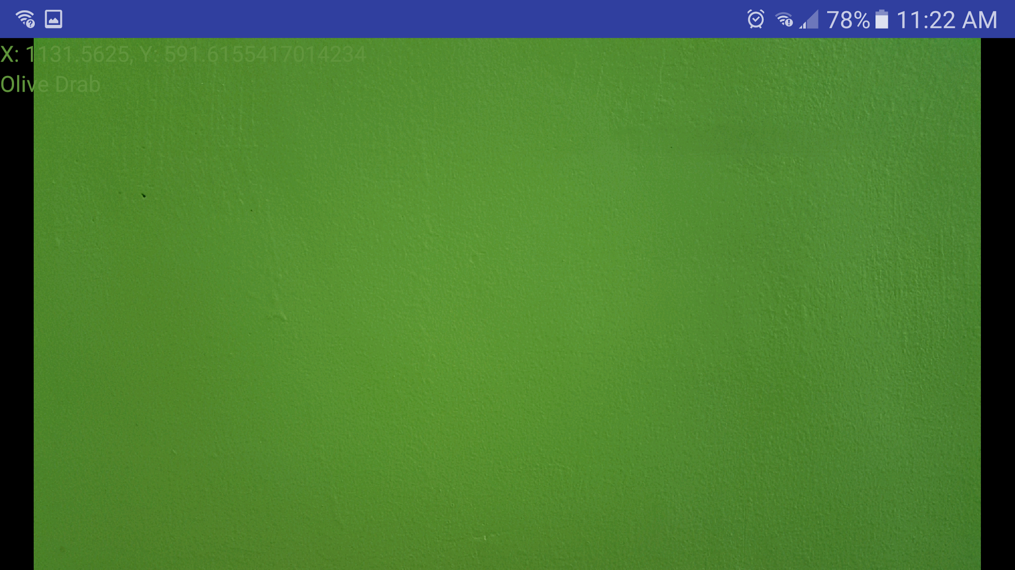
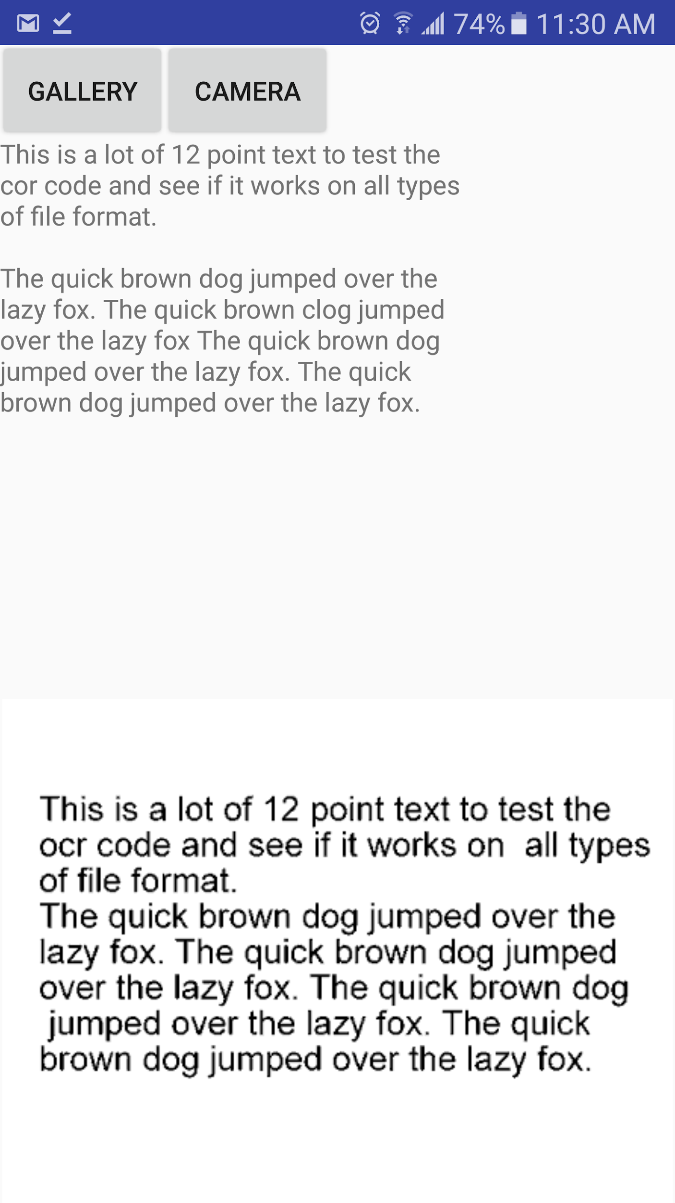
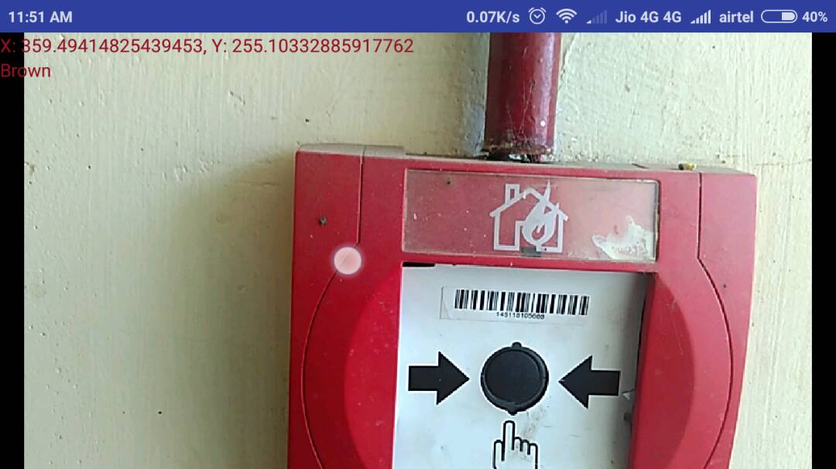
Results

Slide 6
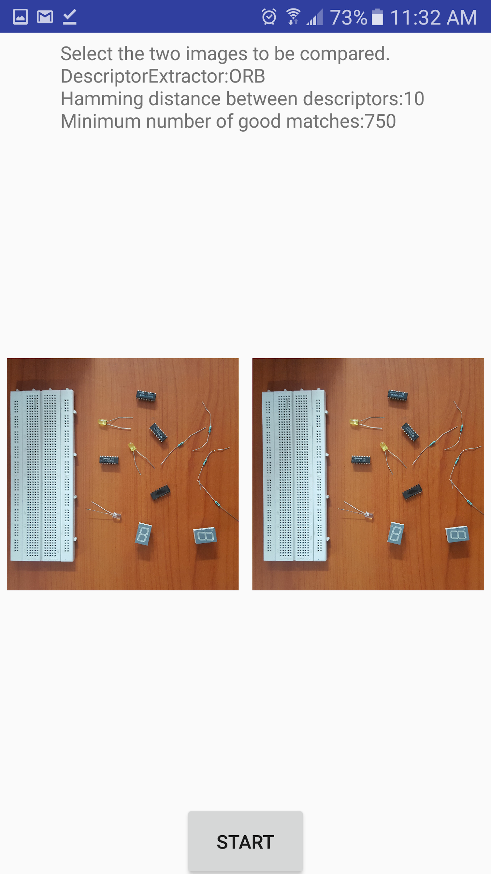
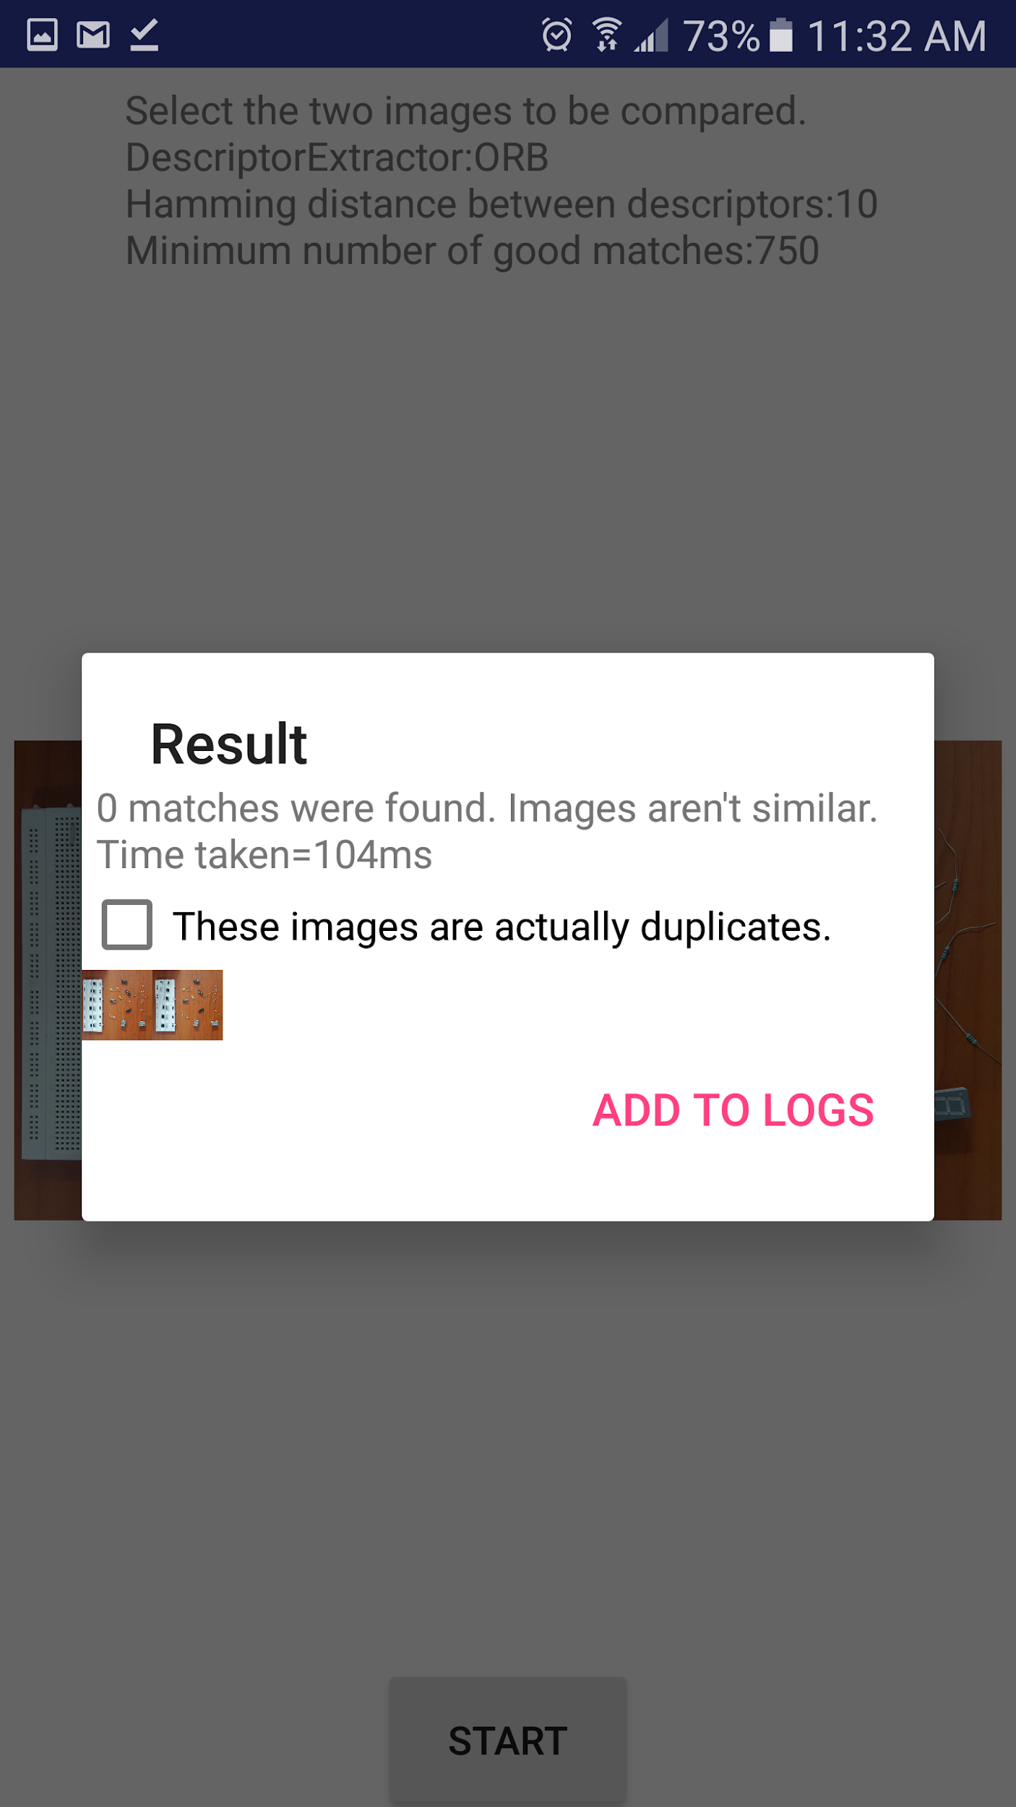
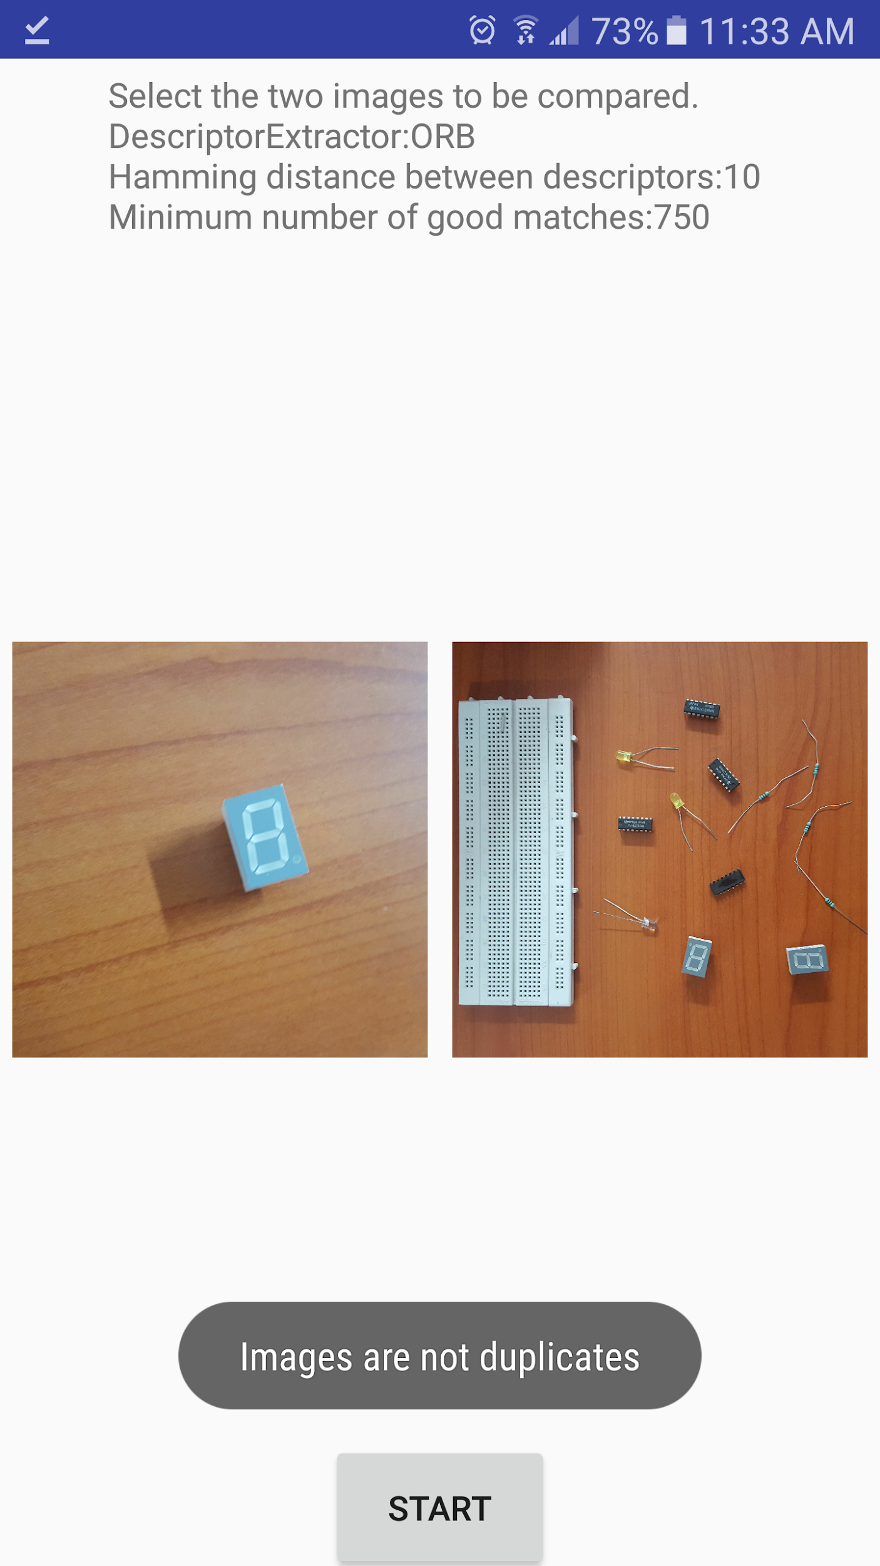
Results

Slide 7
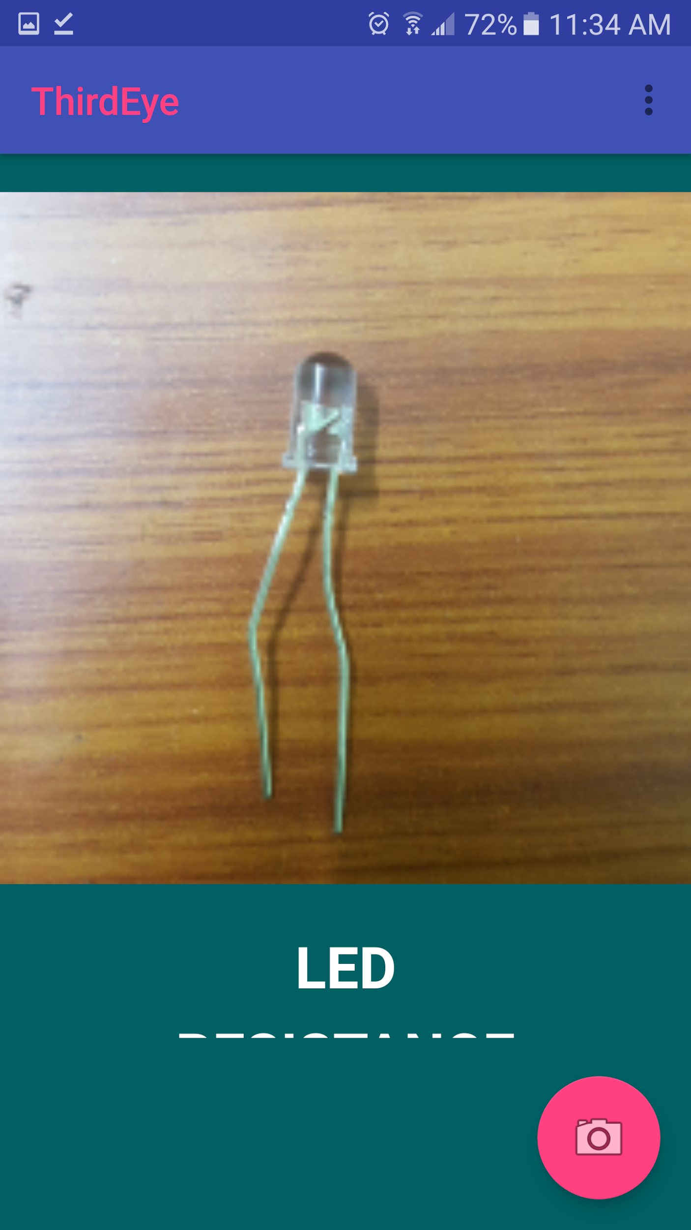
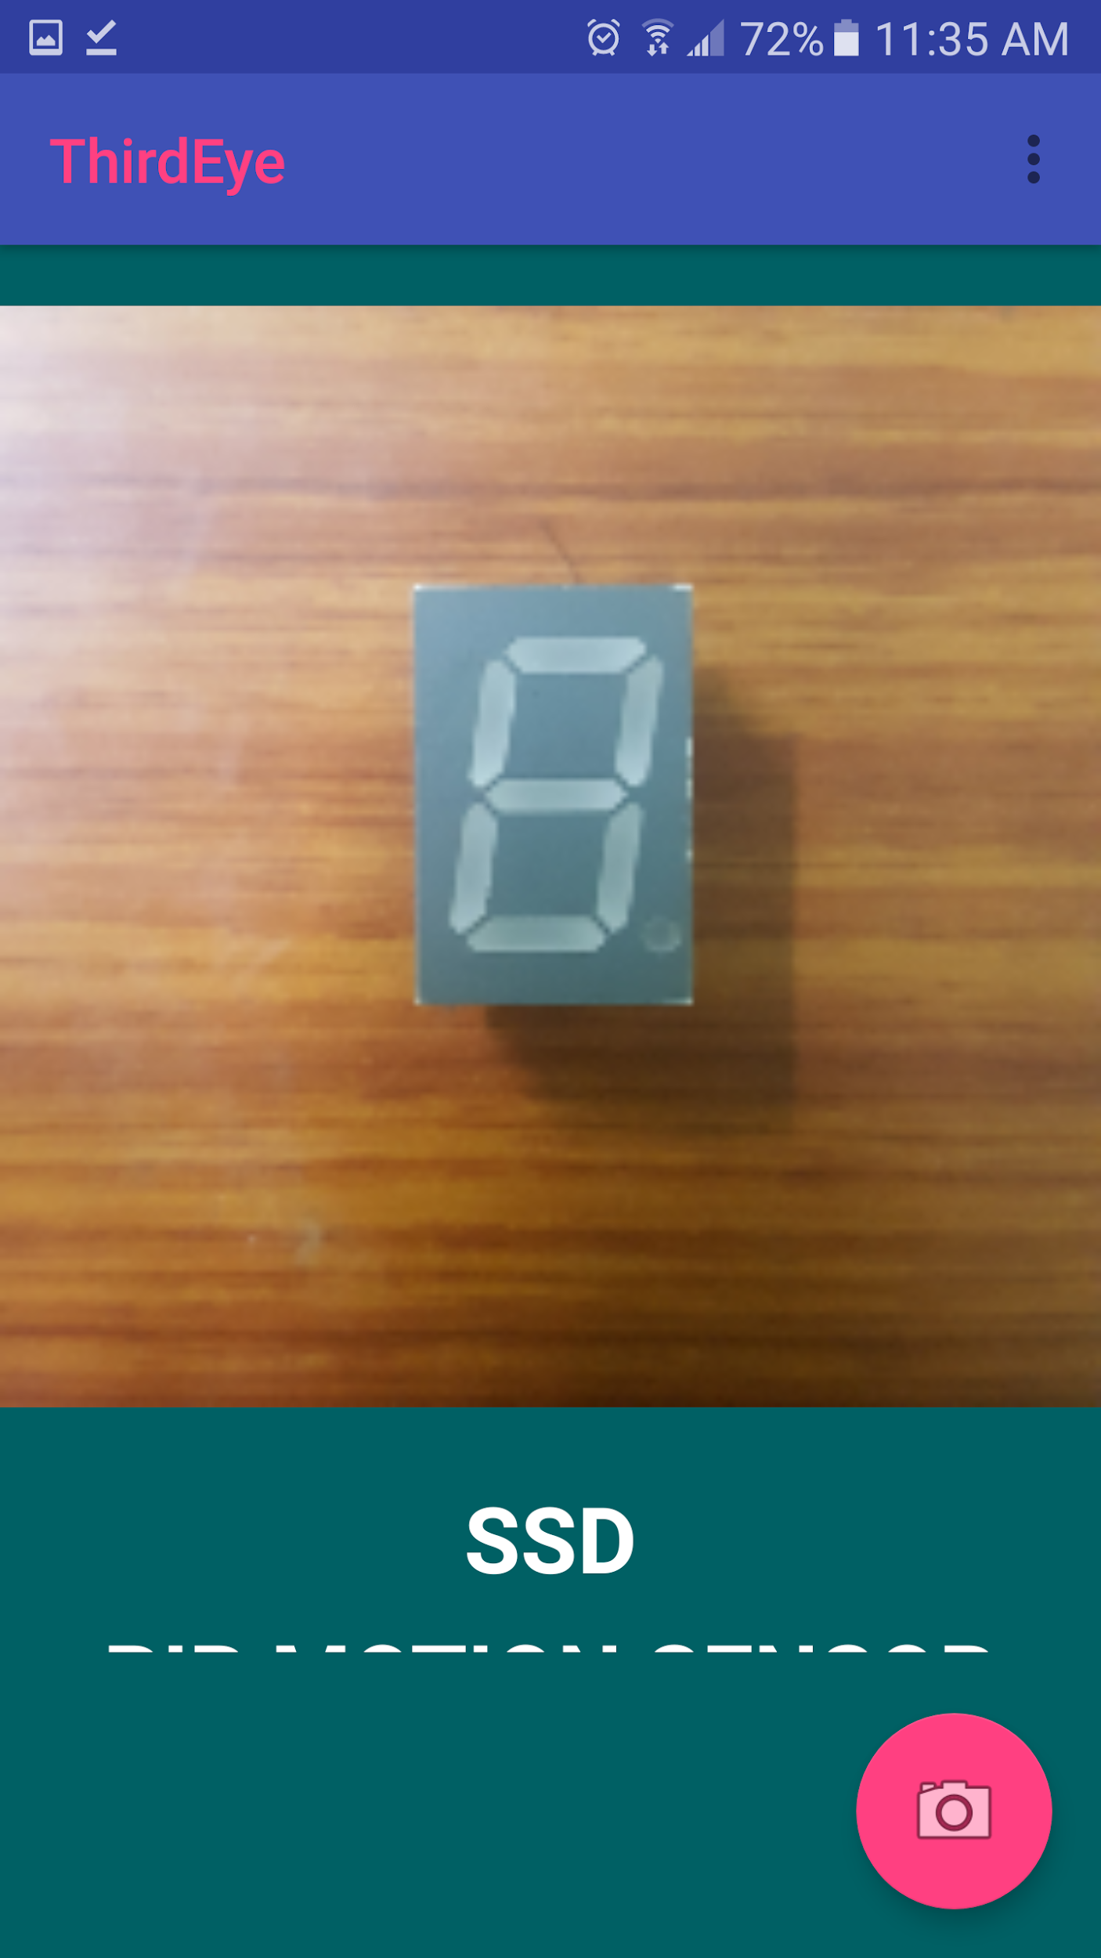
Results

Slide 8
THANK YOU

